Slide 1

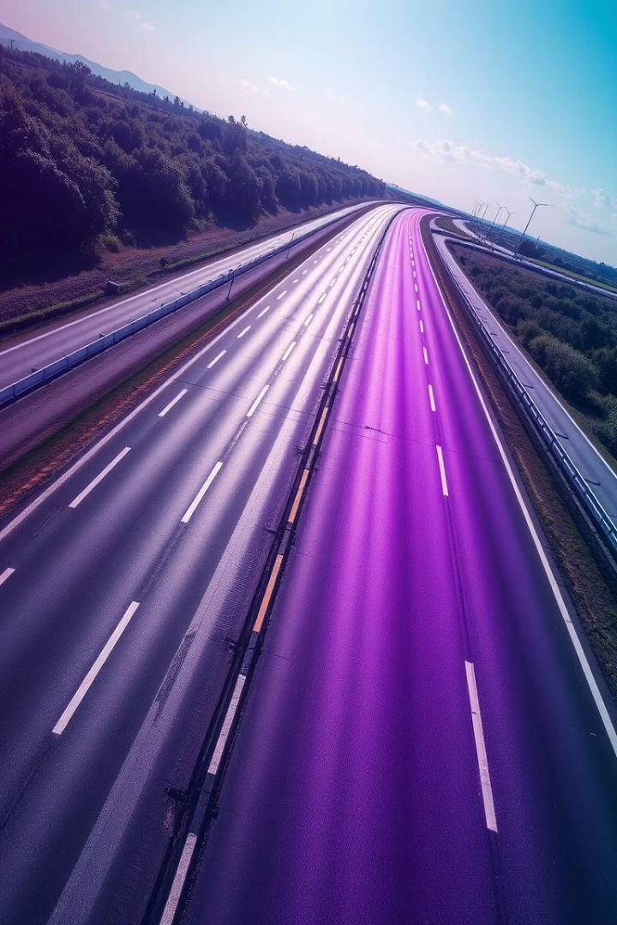
Road Surface Deterioration Detection
Using ITS, AI, and IoT
By Aditya Prakash Bhagchandani Robotics And Automation Engineering Major Under the Supervision of Dr. Amr Talaat
Notes:
Topic name
My name major
Supervisiers name

Slide 2
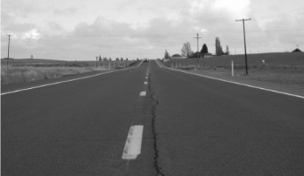
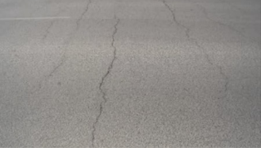
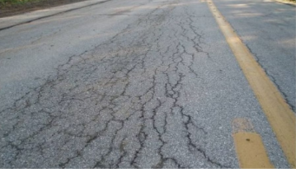
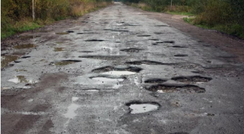

Road Surface Deterioration & its Impact
Types of Cracks:
Longitudinal Cracks (D00) Source: Engineering Discoveries
Transverse Cracks (D10) Source: ResearchGate
Alligator Cracks (D20) Source: Preventive Maintenance
Potholes (D40) Source: DePaula Chevrolet
Threat to Life and Safety
Impact on The Economy
According to the Road Accident Report for the year 2022 released by Ministry of Transport in India.
The House of Common Library Report in UK found:
20% of carriageway maintenance budgets are assigned to immediate repairs. Which increases when cracks become potholes.
Accidents due to potholes have increased by 22.6% Deaths due to potholes have increased by 25.3%
Enormous backlog of repairs to potholes during 2022/23, estimated at close to £968.9 million.
Notes:
Multiple types of cracks but focus on these
All cracks form into potholes
Which makes economic impact such as uk report
That’s not the only case
Life threathing

Slide 3
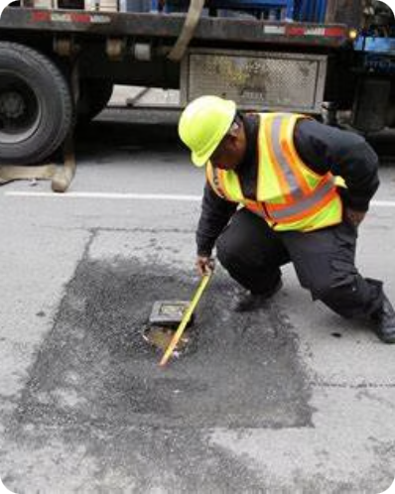
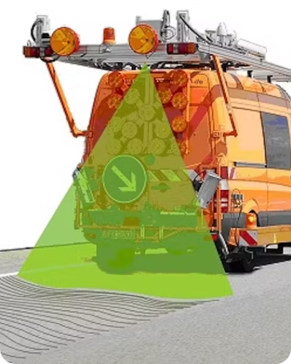
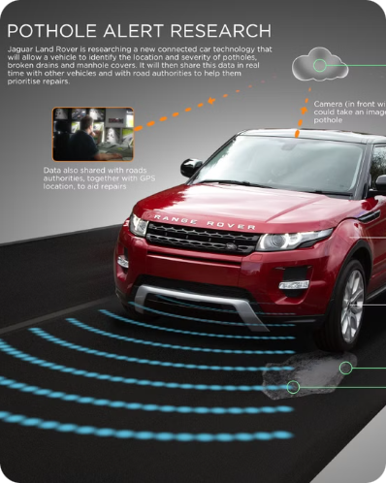
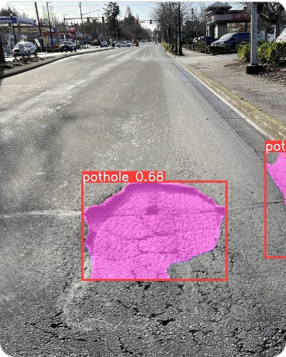
Existing Solutions
Manual Inspections
Laser-based Imaging
Vehicle Sensors
AI-Based Approaches
Time-consuming, inconsistent, and expensive
Accurate but requires expensive equipment
Relies on maintenance and calibration of vehicles
Promising but requires further research
Notes:
Ai
Large models
Low diversity
Low amount
Not a good performance

Slide 4
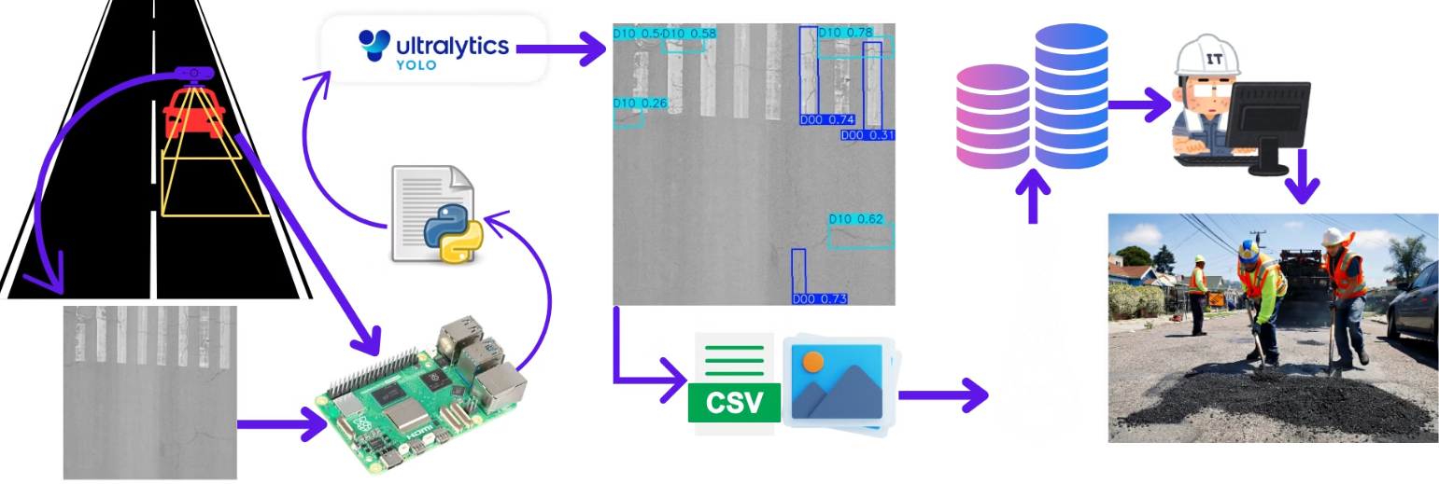
Proposed Solution
1
Lightweight Machine Learning Model
2
Dashcam & Edge Computing
3
Automated Reporting
Detects and reports road deterioration to authorities.
Trained on diverse and large dataset and optimized
Easy Installation and retro fit.

Slide 5

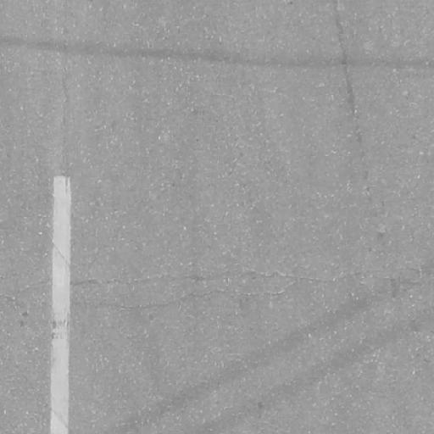
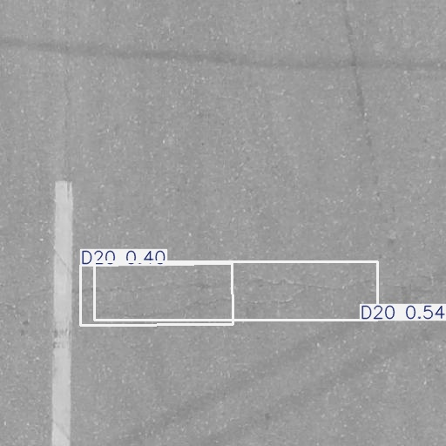
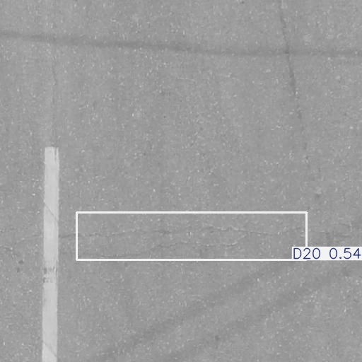
Proposed Solutions
Overview:
Gray scaled
640 by 640 Pixels
Model
Prediction
Non-Maximum
Suppression

Slide 6
Content of the Day
Dataset & Model Selection
1
2
Comparison Metrics
Training and optimizing the final model
3
4
Benchmarking
Results
5
6
Conclusion & Future work
GitHub Link for the References
7

Slide 7
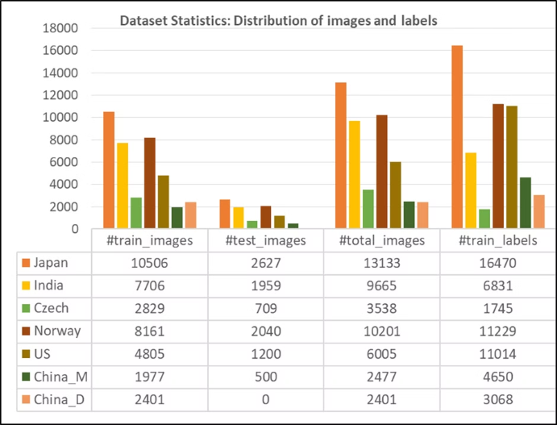
Dataset & Model Selection
Dataset
RDD2022 provide by Crowd Sensing based Road Damage Detection challenge (CRDDC’2022)
Pothole Dataset V8 for Detection by DenisG04 on Kaggle
Contains 7767 Images annotate for potholes.
Electrical and Electronic Department, Stelllenbosch University, 2015 Dataset.
All pothole images from RDD2022 dataset.
And multiple YouTube Videos
Final Dataset:
Both datasets were merged in the case of duplicates the RDD2022 files were taken.
The dataset is split into three parts randomly: (80%) Train, (10%) Valid, (10%) Test
The images are resized to 640 by 640 pixels and grayscale.
All the annotations are formatted according to each model's requirement.

Slide 8
Dataset & Model Selection
Model Selection
Name
YOLOv3 Tiny
Yolov7
YOLO11n
YOLO11n-OBB
YOLO11n-Seg
Parameters
8.848 million
36.9 million
2.6 million
2.7 million
2.9 million
FLOPs
5.582 GFLOPs
104.7 GFLOPS
6.5 GFLOPs
17.2 GFLOPs
10.4 GFLOPs
COCO mAP
35.9%
51.4%
39.5%
39.5%
38.9%
Framework
Darknet
Darknet
PyTorch
PyTorch
PyTorch
Notes:
Yolo models because of their well document and ease of use
Yolo v3 tiny and yolov7 because mainly implemented yolos except 4 also
11 series released in 2024

Slide 9
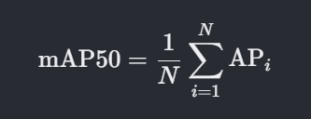
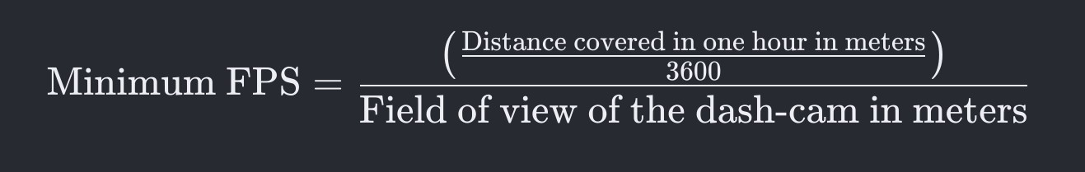
Comparison Metrics
Mean Average Precision at 50% IoU (mAP50 ) - Accuracy Metric
Average Precision (AP): Area under the curve of PR graph. It summarizes the precision and recall at different thresholds.
Recall (R): The ratio of true positive detections to the total number of actual positives (true positives + false negatives)
Precision (P): The ratio of true positive detections to the total number of positive detections (true positives + false positives).
IoU (Intersection over Union): Percentage of the overlap of predicated and actual bounding box.
Frames Per Second (FPS) - Performance Metric
Notes:
Recall truth over all truth
Precision truth over all detected truth

Slide 10
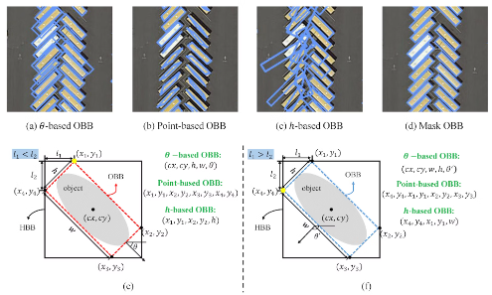
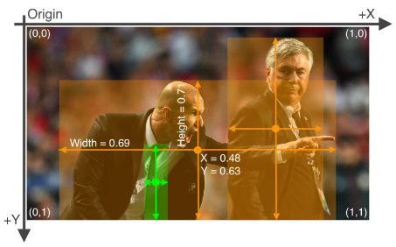
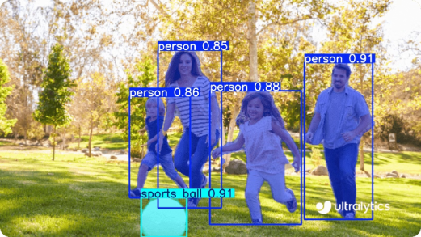
Training and optimizing the final model
Different Formats
YOLO OBB FORMAT
YOLO FORMAT
YOLO Seg FORMAT
Training Hardware
GPU: RTX 3050ti (Laptop Edition) 4 GB dedicated memory, TDP of 75w and with CUDA enabled.
RAM: 16GB.
Processor: Intel i7 12th Gen H-Series (Laptop Edition).
Operating System: Windows 11.
Notes:
Explain each model format

Slide 11
Training and optimizing the final model
Phase 3
Phase 2
Model pruning for optimization.
Phase 1
Extended training with the selected model
Training all models for minimum cycle to select the best one

Slide 12
Training and optimizing the final model
Phase 1
Training Cycle
Darknet Models
PyTorch Model
After going through multiple YOLO model training tutorials 100 Epochs was found to be the suitable number of cycles.
Result
Name
YOLOv3 Tiny
Yolov7
YOLO11n
YOLO11n-OBB
YOLO11n-Seg
Training Cycle
8000 Cycles
8000 Cycles
8000 Cycles
100 Epochs
100 Epochs
mAP50
36.57%
41.23%
56.95%
67.34%
47.27%

Slide 13
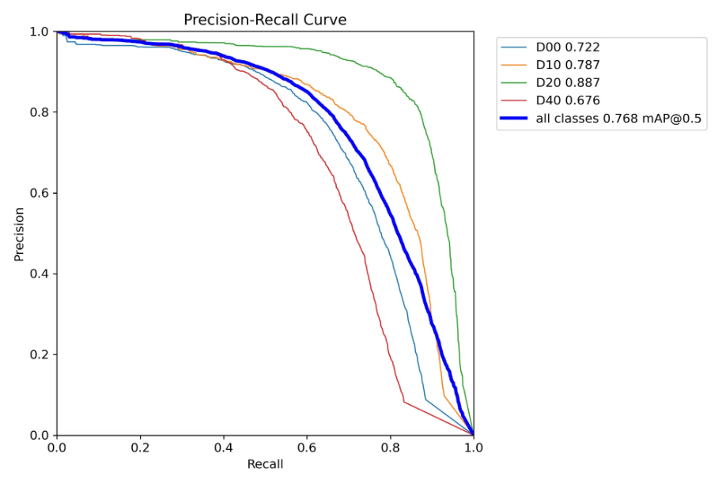
Training and optimizing the final model
Phase 2
Model Selected
YOLO11n-OBB
Training Cycle
Trained for 450 Epochs
Results
mAP50 score of 76.89% was achieved
Notes:
Explain results and say lowest perfoming is potholes 67%6

Slide 14
Training and optimizing the final model
Phase 3
Taken an inspiration from CSDN Blog by the user 数学人学python regarding pruning YOLO11 model.
Techniques Applied:
Threshold-Based Pruning: Removes less significant weights based on predefined thresholds.
Layer-Wise Pruning: Selectively prunes entire layers to enhance efficiency.
Sequential Pruning: Ensures pruning does not disrupt network architecture.
Distillation Loss: Helps retain knowledge from the original model while pruning.
Implementation:
Applied pruning at 90% and 80%.
Saved optimized model for benchmarking on edge devices.
Notes:
Zero point Quantization
Pruning unstructured with threshold
Knowledege distillation applied to reduce further

Slide 15
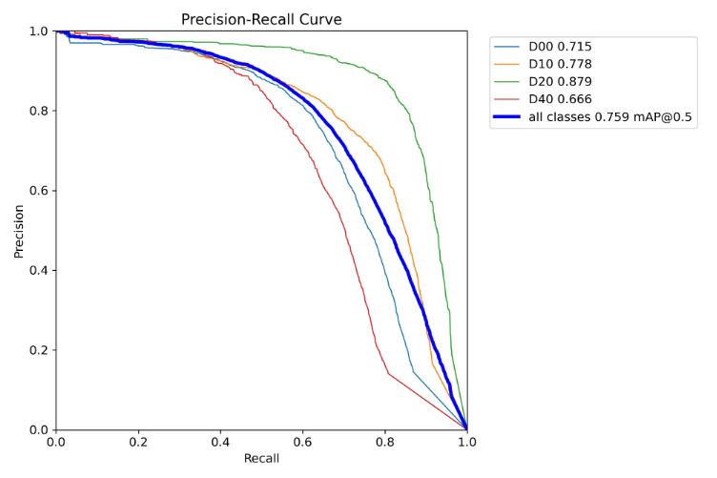
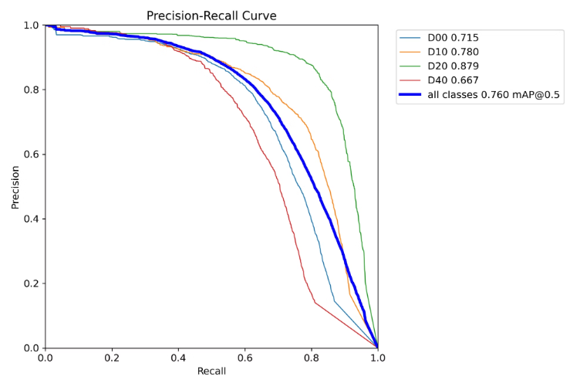
Training and optimizing the final model
Phase 3
Results
Pruned at 80%
Pruned at 90%
Notes:
Explain results
75.9
76

Slide 16
Benchmarking
The purpose of benchmarking is to get FPS of the model and also the real life mAP50 score.
Results
A minimum FPS of 9 is need to be applicable for real life using while noting FOV of the dash cam is 2 M and speed is under 60 KM/H
Best Export Format for each model is selected for comparison based on FPS.
Hardware Details
Model Name
Format
FPS
mAP50
Loss
Device: Raspberry Pi 5.
YOLO11n-OBB Original
NCNN
9.56
75.50%
1.80%
RAM: 8GB.
Storage: 32GB.
Power Supply: 5V, 5A adapter.
YOLO11n-OBB 90%
NCNN
10
74.60%
1.84%
Operating System: Ubuntu 24.04 LTS.
Benchmark Method
YOLO11n-OBB 80%
OpenVINO
12.5
74.50%
1.84%
Using test part of the dataset section
Models are exported in multiple formats and benchmarked

Slide 17
Conclusion & Future work
Conclusion
Future Work
All the benchmarked models are suitable for real life application on edge devices
Further Pruning & Quantization: Additional pruning techniques and weight quantization can be explored to further reduce model size and increase FPS.
Models are trained on diverse and large dataset
YOLO11n-OBB pruned at 80 percent shows improvement of 30.75% percent in FPS while loss of 1.32% in accuracy
Enhancing Detection Capabilities: Expand the dataset to include more weather conditions and night vison.
Integration with IoT: Deploy the optimized model on smart city infrastructure for real-time reporting of road conditions to municipal authorities.
Benchmarking Methods: Creating a standardized benchmarking dataset for accurate comparison and standard hardware with real life system implemented for more accurate results in accuracy and performance

Slide 18

Thank You For Your Time Any Questions ?
All the references and materials regarding the project and presentation are available on this GitHub repo.
Yuvadi/Road-Damage-Detection: Bsc. Thesis on Road surface deterioration detection using AI, ITS and IoT

